Slide 1
Computer Architecture & Assembly Language
CSC-250
COURSE LECTURE
COMPUTER SCIENCE DEPARTMENT
SIBAU KANDHKOT CAMPUS

Slide 2
Top Level Architecture
Computer Components
Computer Function
Interconnection Structure
BUS Interconnection
PCI

Slide 3
Computer Components
A computer is a complex device containing many sub-systems. Each sub-system is a piece of computer hardware (or part of a piece of computer hardware.)
How these pieces interact is called the "Computer Architecture". The hard of a computer includes:
CPU - the ?brain? of the computer
Motherboard - The spine of the computer
Power Supply - the ?stomach? of the computer
BUS - "trucks" data around the computer
Clock - tells the CPU to start the next instruction
Network Card - the ?cell phone? of the computer
Monitor - the ?face? of the computer
Fans - computers can cook food, they are so hot. We must cool them down.

Slide 4
Computer Components
virtually all contemporary computer designs are based on concepts developed by John von Neumann at the Institute for Advanced Studies, Princeton. Such a design is referred to as the von Neumann architecture and is based on three key concepts:
Data and instructions are stored in a single read–write memory.
The contents of this memory are addressable by location, without regard to the type of data contained there.
Execution occurs in a sequential fashion (unless explicitly modified) from oneinstruction to the next.

Slide 5
Computer Components
Memory
Memory Layers
Registers (1 clock cycle)
Primary Cache: ~1 nano-second cache primary
Secondary Cache: 10 nano-seconds
fast RAM: 70 nanoseconds or less
fast disk: 10 milliseconds (10,000,000 nanoseconds)
CD/DVD: 160 milliseconds (160,000,000 nanoseconds)

Slide 6
Computer Components
IO Devices
CPU
Memory
Graphics Card / Monitor
Keyboard
Disk Drive
Tape Backup
CD ROM

Slide 7
Computer Components
  Originally computers used a Hardwired program
  The result of the process of connecting the various components in the desired configuration
  The computer must be rewired to run a different program
Contemporary computer designs are based on concepts developed by John von Neumann at the Institute for Advanced Studies, Princeton
Referred to as the von Neumann architecture it has three key concepts:
  Data and instructions are stored in a single read-write memory
  The contents of this memory are addressable by location, without regard to the type of data contained there
  Execution occurs in a sequential fashion (unless explicitly modified) from one instruction to the next
Notes:
As discussed in Chapter 2, virtually all contemporary computer designs are based
on concepts developed by John von Neumann at the Institute for Advanced Studies,
Princeton. Such a design is referred to as the von Neumann architecture and is based
on three key concepts:
• Data and instructions are stored in a single read–write memory.
• The contents of this memory are addressable by location, without regard to
the type of data contained there.
• Execution occurs in a sequential fashion (unless explicitly modified) from one
instruction to the next.
The reasoning behind these concepts was discussed in Chapter 2 but is worth
summarizing here. There is a small set of basic logic components that can be
combined in various ways to store binary data and perform arithmetic and logical
operations on that data. If there is a particular computation to be performed, a
configuration of logic components designed specifically for that computation could
be constructed. We can think of the process of connecting the various components
in the desired configuration as a form of programming. The resulting “program” is
in the form of hardware and is termed a hardwired program.

Slide 8
What is a program?
A sequence of steps
arithmetic or logical operation is done
a different set of
control signals is needed

Slide 9
Function of Control Unit
A unique code for each operation
  Example: ADD, MOVE
Hardware Segment
Accept codes
Issues control signals

Slide 10
Computer Components
Computer
PC = Program Counter
IR = Instruction Register
MAR = Memory Address Register
MBR = Memory Buffer Register
I/O AR = Input/Output Address Register
I/O BR = Input/Output Buffer Register
Central Processing Unit (CPU)
PC
MAR
System
Bus
Main Memory
.
MBR
.
IR
.
0
1
2
.
.
.
I/O AR
Instruction
Execution Unit
Instruction
I/O BR
.
.
.
Data
I/O Module
Buffers
Data
.
.
.
.
.

Slide 11
Fetch Cycle
Program Counter (PC)
Holds address of next instruction to fetch
Processor
Fetch instruction from memory location pointed to by PC
Increment PC
Instruction Register (IR)
Load the instruction
Processor
Interprets instruction
Perform required actions

Slide 12
Execute Cycle
Processor I/O
Execution Cycle
Processor -Memory
Data Processing
Control

Slide 13
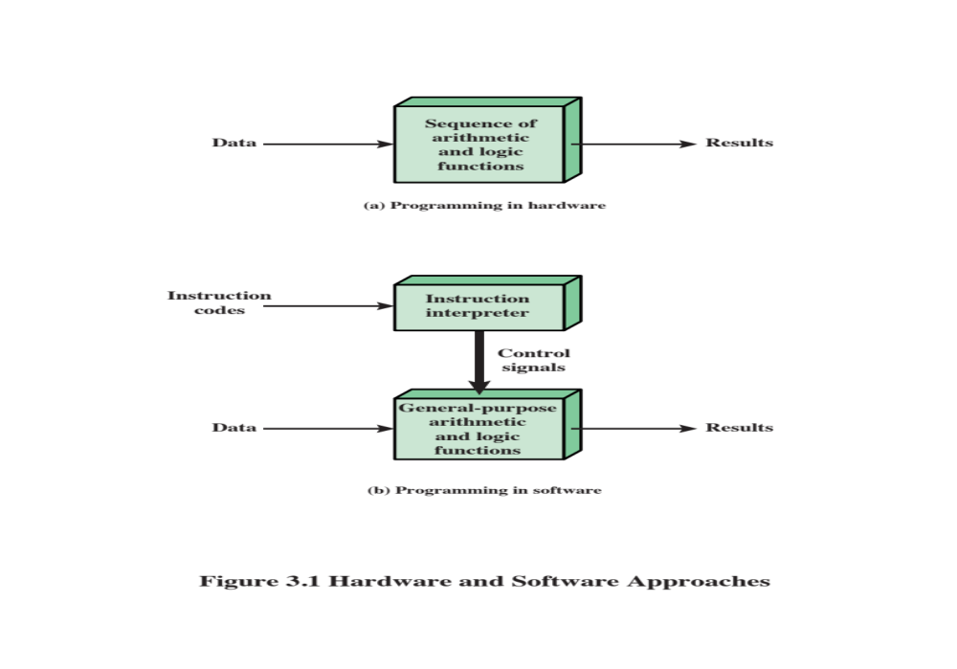
Hardware and Software Approaches
Notes:
Now consider this alternative. Suppose we construct a general-purpose
configuration of arithmetic and logic functions. This set of hardware will perform
various functions on data depending on control signals applied to the hardware.
In the original case of customized hardware, the system accepts data and produces
results (Figure 3.1a). With general-purpose hardware, the system accepts data and
control signals and produces results. Thus, instead of rewiring the hardware for each
new program, the programmer merely needs to supply a new set of control signals.
How shall control signals be supplied? The answer is simple but subtle. The
entire program is actually a sequence of steps. At each step, some arithmetic or
logical operation is performed on some data. For each step, a new set of control
signals is needed. Let us provide a unique code for each possible set of control
signals, and let us add to the general-purpose hardware a segment that can accept a
code and generate control signals (Figure 3.1b).

Slide 14

I/O
Components
Software
A sequence of codes or instructions
Part of the hardware interprets each instruction and generates control signals
Provide a new sequence of codes for each new program instead of rewiring the hardware
Major components:
Means of reporting results
Output module
Contains basic components for accepting data and instructions and converting them into an internal form of signals usable by the system
Input module
I/O Components
Module of general-purpose arithmetic and logic functions
Instruction interpreter
CPU
Software
Notes:
Programming is now much easier. Instead of rewiring the hardware for each
new program, all we need to do is provide a new sequence of codes. Each code
is, in effect, an instruction, and part of the hardware interprets each instruction
and generates control signals. To distinguish this new method of programming, a
sequence of codes or instructions is called software.
Figure 3.1b indicates two major components of the system: an instruction
interpreter and a module of general-purpose arithmetic and logic functions. These
two constitute the CPU. Several other components are needed to yield a functioning
computer. Data and instructions must be put into the system. For this we need some
sort of input module. This module contains basic components for accepting data
and instructions in some form and converting them into an internal form of signals
usable by the system. A means of reporting results is needed, and this is in the form
of an output module. Taken together, these are referred to as I/O components.

Slide 15
MEMORY
Memory address register (MAR)
Specifies the address in memory for the next read or write
Memory buffer register (MBR)
Contains the data to be written into memory or receives the data read from memory
I/O address register (I/OAR)
Specifies a particular I/O device
I/O buffer register (I/OBR)
Used for the exchange of data between an I/O module and the CPU
MAR
MBR
Notes:
One more component is needed. An input device will bring instructions and
data in sequentially. But a program is not invariably executed sequentially; it may
jump around (e.g., the IAS jump instruction). Similarly, operations on data may
require access to more than just one element at a time in a predetermined sequence.
Thus, there must be a place to store temporarily both instructions and data. That
module is called memory, or main memory, to distinguish it from external storage or
peripheral devices. Von Neumann pointed out that the same memory could be used
to store both instructions and data.
The CPU exchanges data with memory. For this purpose, it typically
makes use of two internal (to the CPU) registers: a memory address register (MAR),
which specifies the address in memory for the next read or write, and a memory
buffer register (MBR), which contains the data to be written into memory or receives
the data read from memory. Similarly, an I/O address register (I/OAR) specifies a
particular I/O device. An I/O buffer (I/OBR) register is used for the exchange of
data between an I/O module and the CPU.

Slide 16

Fetch Cycle
At the beginning of each instruction cycle the processor fetches an instruction from memory
  The program counter (PC) holds the address of the instruction to be fetched next
  The processor increments the PC after each instruction fetch so that it will fetch the next instruction in sequence
The fetched instruction is loaded into the instruction register (IR)
  The processor interprets the instruction and performs the required action
Notes:
At the beginning of each instruction cycle, the processor fetches an instruction
from memory. In a typical processor, a register called the program counter (PC)
holds the address of the instruction to be fetched next. Unless told otherwise, the
processor always increments the PC after each instruction fetch so that it will fetch
the next instruction in sequence (i.e., the instruction located at the next higher memory
address). So, for example, consider a computer in which each instruction occupies
one 16-bit word of memory. Assume that the program counter is set to memory
location 300, where the location address refers to a 16-bit word. The processor will
next fetch the instruction at location 300. On succeeding instruction cycles, it will
fetch instructions from locations 301, 302, 303, and so on. This sequence may be
altered, as explained presently.
The fetched instruction is loaded into a register in the processor known as
the instruction register (IR). The instruction contains bits that specify the action
the processor is to take. The processor interprets the instruction and performs the
required action.

Slide 17
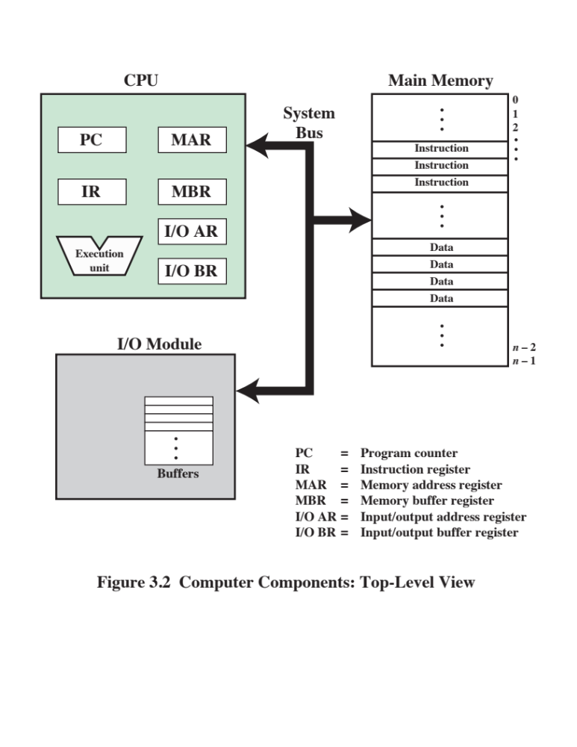
Notes:
Figure 3.2 illustrates these top-level components and suggests the interactions
among them.
A memory module consists of a set of locations, defined by sequentially
numbered addresses. Each location contains a binary number that can be interpreted
as either an instruction or data. An I/O module transfers data from external devices
to CPU and memory, and vice versa. It contains internal buffers for temporarily
holding these data until they can be sent on.

Slide 18
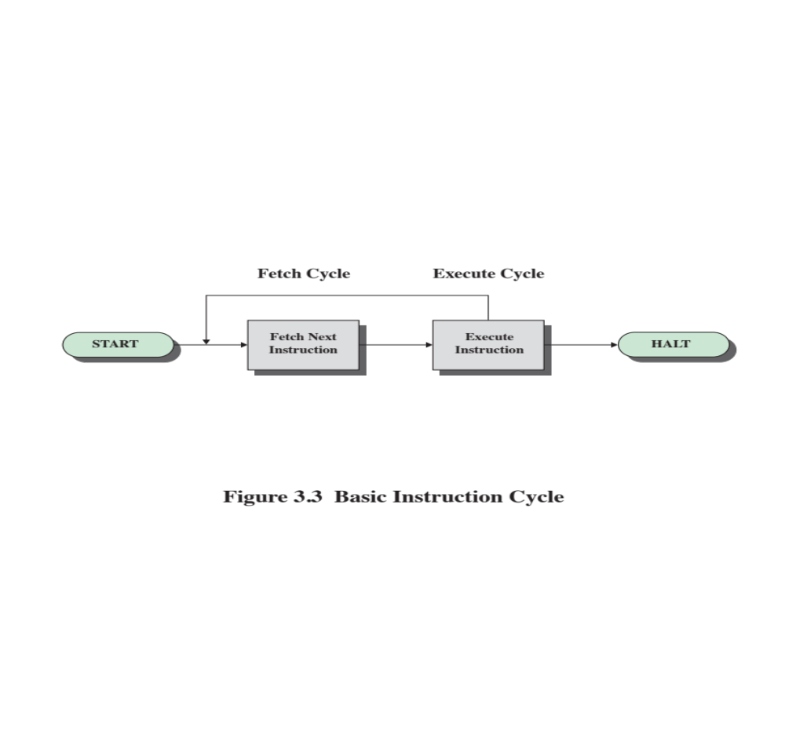
Fetch Cycle/Execute Cycle
We will expand and add details to these basic fetch and execute cycles throughout the lecture
Notes:
The basic function performed by a computer is execution of a program, which consists
of a set of instructions stored in memory. The processor does the actual work by
executing instructions specified in the program. This section provides an overview of
the key elements of program execution. In its simplest form, instruction processing
consists of two steps: The processor reads (fetches ) instructions from memory one
at a time and executes each instruction. Program execution consists of repeating
the process of instruction fetch and instruction execution. The instruction execution
may involve several operations and depends on the nature of the instruction (see, for
example, the lower portion of Figure 2.4).
The processing required for a single instruction is called an instruction cycle.
Using the simplified two-step description given previously, the instruction cycle is
depicted in Figure 3.3. The two steps are referred to as the fetch cycle and the execute
cycle. Program execution halts only if the machine is turned off, some sort of unrecoverable
error occurs, or a program instruction that halts the computer is encountered.

Slide 19
Action Categories
Processor-memory
Data transferred from processor to memory or from memory to processor
Processor-I/O
Data transferred to or from a peripheral device by transferring between the processor and an I/O module
Data processing
The processor may perform some arithmetic or logic operation on data
Control
An instruction may specify that the sequence of execution be altered
Notes:
In general, these actions fall into four categories:
Processor-memory: Data may be transferred from processor to memory or
from memory to processor.
• Processor-I/O: Data may be transferred to or from a peripheral device by
transferring between the processor and an I/O module.
• Data processing: The processor may perform some arithmetic or logic operation
on data.
• Control: An instruction may specify that the sequence of execution be altered.
For example, the processor may fetch an instruction from location 149, which
specifies that the next instruction be from location 182. The processor will
remember this fact by setting the program counter to 182. Thus, on the next
fetch cycle, the instruction will be fetched from location 182 rather than 150.
An instruction’s execution may involve a combination of these actions.

Slide 20
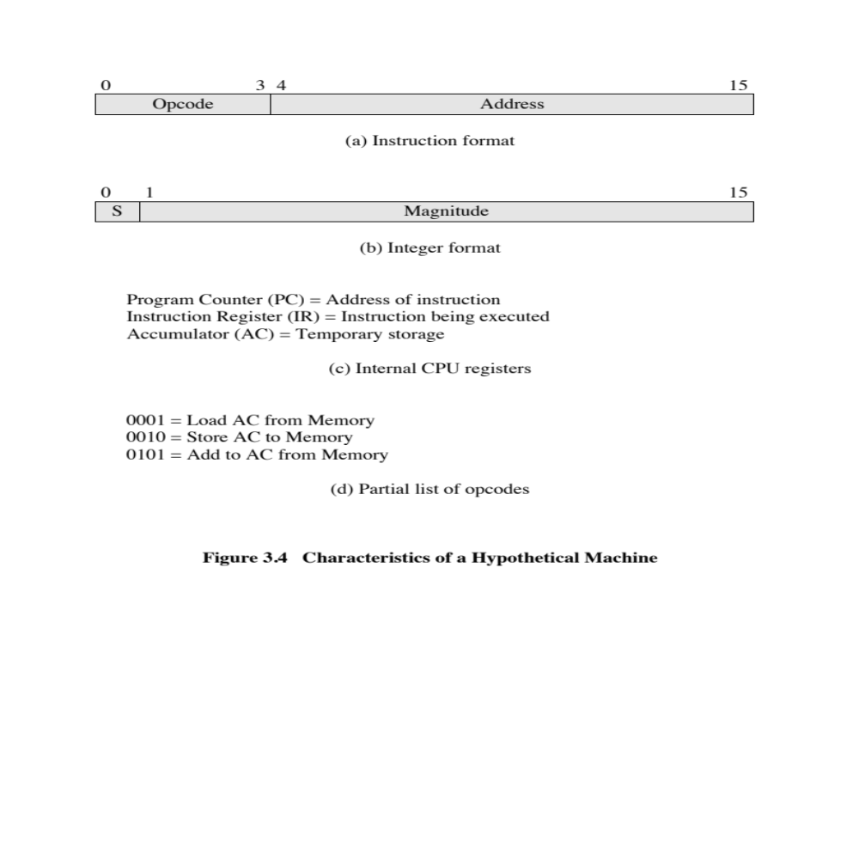
Notes:
Consider a simple example using a hypothetical machine that includes the
characteristics listed in Figure 3.4. The processor contains a single data register,
called an accumulator (AC). Both instructions and data are 16 bits long. Thus, it is
convenient to organize memory using 16-bit words. The instruction format provides
4 bits for the opcode, so that there can be as many as 2⁴ = 16 different opcodes, and
up to 2¹² = 4096 (4K) words of memory can be directly addressed.

Slide 21
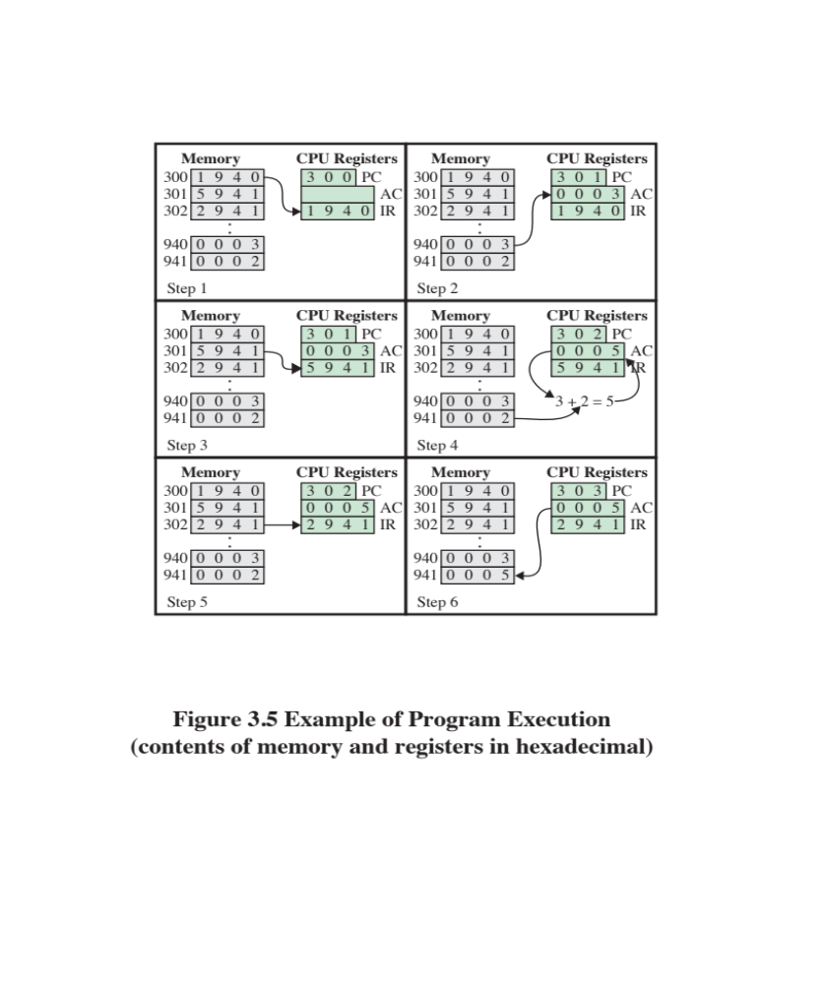
Notes:
Figure 3.5 illustrates a partial program execution, showing the relevant
portions of memory and processor registers. The program fragment shown adds
the contents of the memory word at address 940 to the contents of the memory
word at address 941 and stores the result in the latter location. Three instructions,
which can be described as three fetch and three execute cycles, are required:
1. The PC contains 300, the address of the first instruction. This instruction (the
value 1940 in hexadecimal) is loaded into the instruction register IR, and
the PC is incremented. Note that this process involves the use of a memory
address register and a memory buffer register. For simplicity, these intermediate
registers are ignored.
2. The first 4 bits (first hexadecimal digit) in the IR indicate that the AC is to be
loaded. The remaining 12 bits (three hexadecimal digits) specify the address
(940) from which data are to be loaded.
3. The next instruction (5941) is fetched from location 301, and the PC is
incremented.
4. The old contents of the AC and the contents of location 941 are added, and
the result is stored in the AC.
5. The next instruction (2941) is fetched from location 302, and the PC is
incremented.
6. The contents of the AC are stored in location 941.
In this example, three instruction cycles, each consisting of a fetch cycle and an
execute cycle, are needed to add the contents of location 940 to the contents of 941.
With a more complex set of instructions, fewer cycles would be needed. Some older
processors, for example, included instructions that contain more than one memory
address. Thus, the execution cycle for a particular instruction on such processors could
involve more than one reference to memory. Also, instead of memory references, an
instruction may specify an I/O operation.

Slide 22
Example Program Execution
The PC contains 300, the address of the first instruction.
  Value at address 300 is loaded (1940) into IR
  First digit (1) is the op code (Load AC)
  The last three digits are the address (940)
First instruction is implemented (0003 loaded to AC) and PC is incremented
Next instruction (address 301) is loaded (5941) into IR
  First digit (5) is the op code (Add to AC)
  The last three are the address (941)
The data at address 941 are added to the AC and the PC is incremented
Next instruction (address 302) is loaded (2941) into IR
  First digit (2) is the op code (Store AC)
  The last three are the address (941)
The contents of the AC are written to memory and the PC is incremented

Slide 23
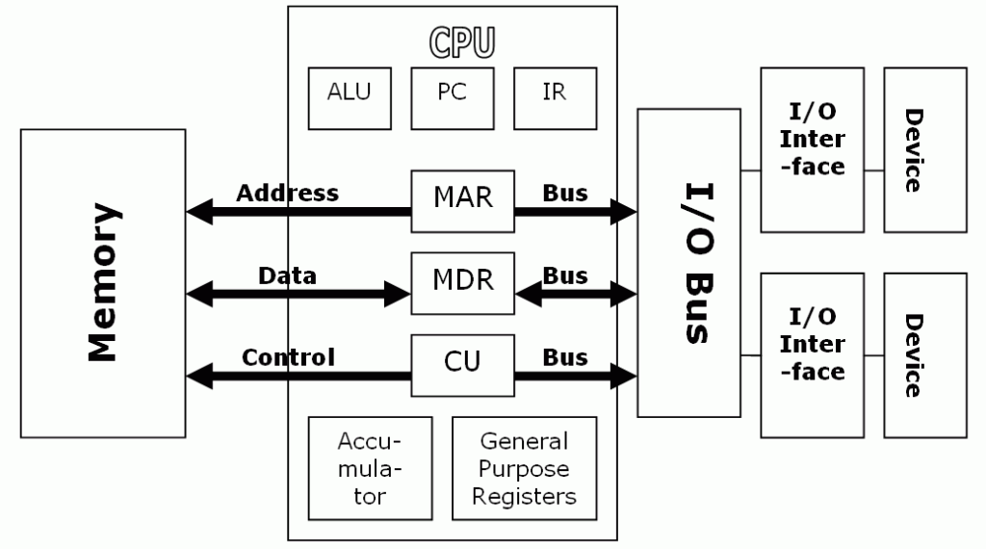

Slide 24
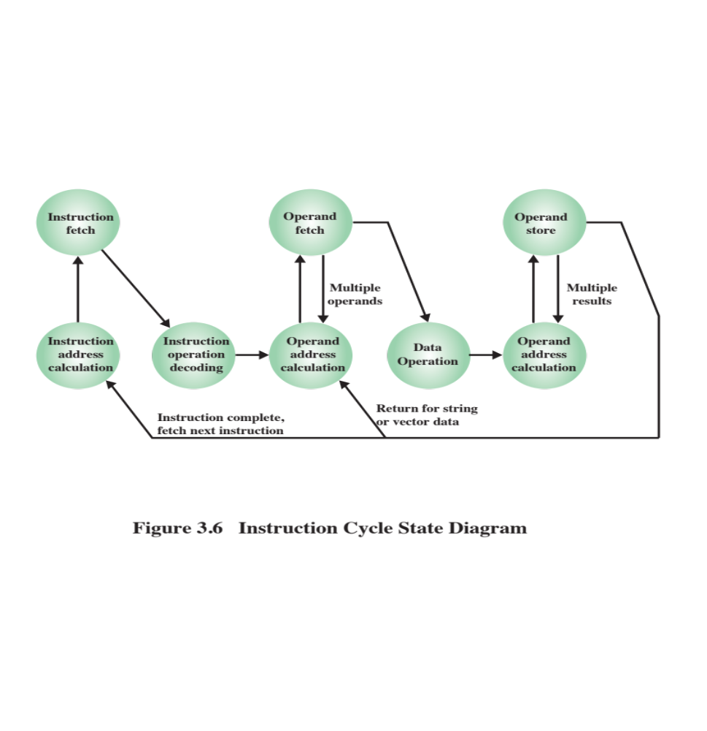
Notes:
The execution cycle for a particular instruction may involve more than one
reference to memory. Also, instead of memory references, an instruction may specify
an I/O operation. With these additional considerations in mind, Figure 3.6 provides
a more detailed look at the basic instruction cycle of Figure 3.3. The figure is in the
form of a state diagram.
For any given instruction cycle, some states may be null and
others may be visited more than once. The states can be described as follows:
• Instruction address calculation (iac): Determine the address of the next
instruction to be executed. Usually, this involves adding a fixed number to
the address of the previous instruction. For example, if each instruction is 16
bits long and memory is organized into 16-bit words, then add 1 to the previous
address. If, instead, memory is organized as individually addressable 8-bit
bytes, then add 2 to the previous address.
• Instruction fetch (if): Read instruction from its memory location into the
processor.
• Instruction operation decoding (iod): Analyze instruction to determine type
of operation to be performed and operand(s) to be used.
• Operand address calculation (oac): If the operation involves reference to an
operand in memory or available via I/O, then determine the address of the
operand.
• Operand fetch (of): Fetch the operand from memory or read it in from I/O.
• Data operation (do): Perform the operation indicated in the instruction.
• Operand store (os): Write the result into memory or out to I/O.
States in the upper part of Figure 3.6 involve an exchange between the
processor and either memory or an I/O module. States in the lower part of the
diagram involve only internal processor operations. The oac state appears twice,
because an instruction may involve a read, a write, or both. However, the action performed
during that state is fundamentally the same in both cases, and so only a single
state identifier is needed.
Also note that the diagram allows for multiple operands and multiple results,
because some instructions on some machines require this. For example, the PDP-11
instruction ADD A,B results in the following sequence of states: iac, if, iod, oac, of,
oac, of, do, oac, os.
Finally, on some machines, a single instruction can specify an operation to be performed
on a vector (one-dimensional array) of numbers or a string (one-dimensional
array) of characters. As Figure 3.6 indicates, this would involve repetitive operand fetch
and/or store operations.

Slide 25
Instruction cycle statements
Instruction fetch (if): Read instruction from its memory location into the
processor.
Instruction operation decoding (iod): Analyze instruction to determine type
of operation to be performed and operand(s) to be used.
Operand address calculation (oac): If the operation involves reference to an
operand in memory or available via I/O, then determine the address of the
operand.
Operand fetch (of): Fetch the operand from memory or read it in from I/O.
Data operation (do): Perform the operation indicated in the instruction.
Operand store (os): Write the result into memory or out to I/O.

Slide 26
Interrupts
An interrupt allows some module (I/O, memory) to stop the normal processing of the processor
  It may or may not resume processing after handling the interrupt
Interrupts are a way to improve processing efficiency
  External devices are slower than the processor
  We don’t want the processor to wait for the printer
  The printer can interrupt the processor when it needs attention
Interrupts are also used to stop a process when some type of error has occurred
  The error may or may not be recoverable

Slide 27
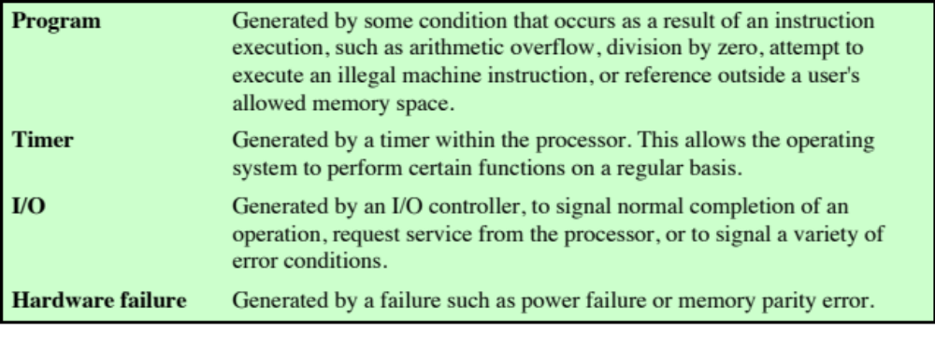
Table 3.1
Classes of Interrupts
Notes:
Virtually all computers provide a mechanism by which other modules (I/O, memory)
may interrupt the normal processing of the processor. Table 3.1 lists the most common
classes of interrupts. The specific nature of these interrupts is examined
later in this book, especially in Chapters 7 and 14. However, we need to introduce the concept
now to understand more clearly the nature of the instruction cycle and the implications
of interrupts on the interconnection structure.

Slide 28
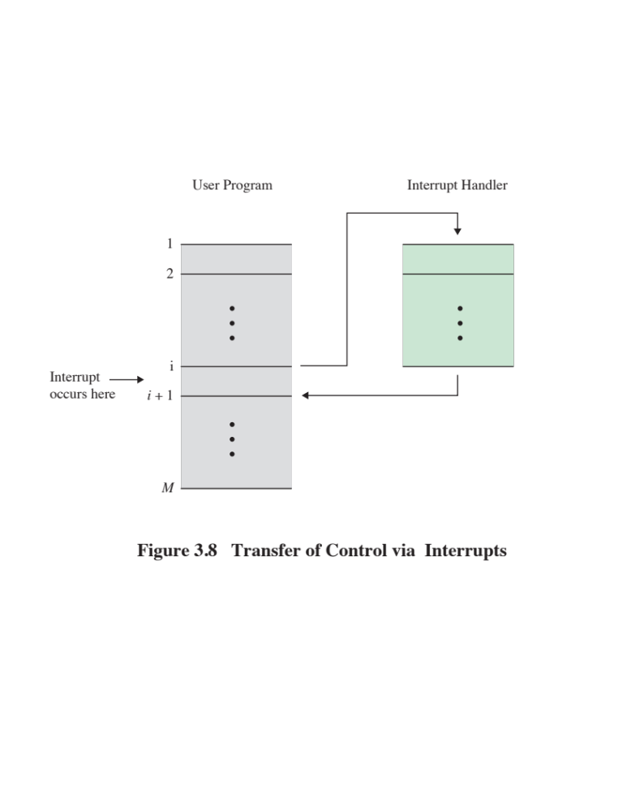
Notes:
From the point of view of the user program, an interrupt is just that: an interruption
of the normal sequence of execution. When the interrupt processing is completed,
execution resumes (Figure 3.8). Thus, the user program does not have to contain any
special code to accommodate interrupts; the processor and the operating system are
responsible for suspending the user program and then resuming it at the same point.

Slide 29
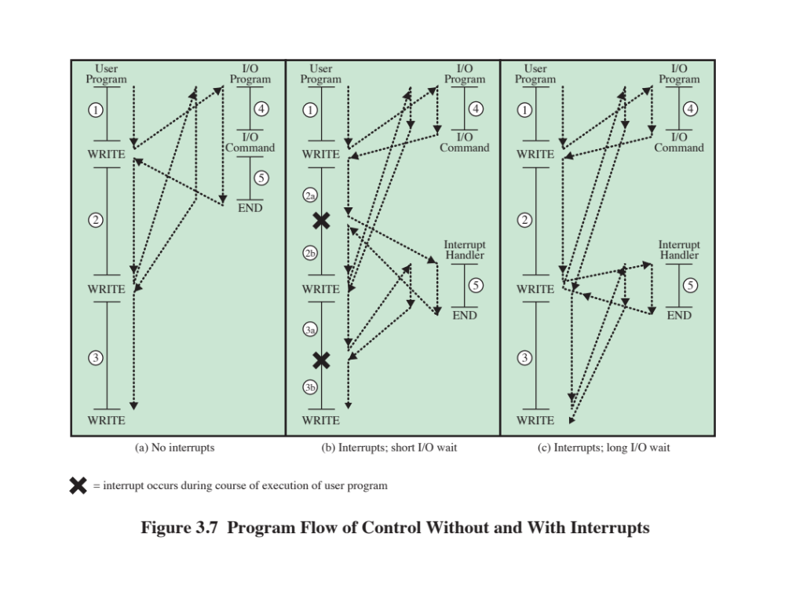
Notes:
Interrupts are provided primarily as a way to improve processing efficiency.
For example, most external devices are much slower than the processor. Suppose
that the processor is transferring data to a printer using the instruction cycle scheme
of Figure 3.3. After each write operation, the processor must pause and remain
idle until the printer catches up. The length of this pause may be on the order of
many hundreds or even thousands of instruction cycles that do not involve memory.
Clearly, this is a very wasteful use of the processor.
Figure 3.7a illustrates this state of affairs. The user program performs a series
of WRITE calls interleaved with processing. Code segments 1, 2, and 3 refer to
sequences of instructions that do not involve I/O. The WRITE calls are to an I/O
program that is a system utility and that will perform the actual I/O operation. The
I/O program consists of three sections:
• A sequence of instructions, labeled 4 in the figure, to prepare for the actual
I/O operation. This may include copying the data to be output into a special
buffer and preparing the parameters for a device command.
• The actual I/O command. Without the use of interrupts, once this command is
issued, the program must wait for the I/O device to perform the requested function
(or periodically poll the device). The program might wait by simply repeatedly
performing a test operation to determine if the I/O operation is done.
• A sequence of instructions, labeled 5 in the figure, to complete the operation.
This may include setting a flag indicating the success or failure of the operation.
Because the I/O operation may take a relatively long time to complete, the I/O
program is hung up waiting for the operation to complete; hence, the user program
is stopped at the point of the WRITE call for some considerable period of time.
With interrupts, the processor can
be engaged in executing other instructions while an I/O operation is in progress.
Consider the flow of control in Figure 3.7b. As before, the user program reaches a
point at which it makes a system call in the form of a WRITE call. The I/O program
that is invoked in this case consists only of the preparation code and the actual I/O
command. After these few instructions have been executed, control returns to the
user program. Meanwhile, the external device is busy accepting data from computer
memory and printing it. This I/O operation is conducted concurrently with the
execution of instructions in the user program.
When the external device becomes ready to be serviced—that is, when it is
ready to accept more data from the processor—the I/O module for that external
device sends an interrupt request signal to the processor. The processor responds by
suspending operation of the current program, branching off to a program to service
that particular I/O device, known as an interrupt handler, and resuming the original
execution after the device is serviced. The points at which such interrupts occur are
indicated by an asterisk in Figure 3.7b.
Let us try to clarify what is happening in Figure 3.7. We have a user program
that contains two WRITE commands. There is a segment of code at the beginning,
then one WRITE command, then a second segment of code, then a second WRITE
command, then a third and final segment of code. The WRITE command invokes the
I/O program provided by the OS. Similarly, the I/O program consists of a segment
of code, followed by an I/O command, followed by another segment of code. The I/O
command invokes a hardware I/O operation.

Slide 30
Interrupts
In these examples a “write” involves three steps:
  Preprocessing
  The write itself which takes place on a peripheral device
  Post processing
The first system, without interrupts, must wait during each write operation
The second system, with interrupts, can initiate the write and then proceed with normal operations
  When the write is complete the processor is interrupted do the postprocessing necessary at the end of the write
On the third system the processor tries to initiate a second write before the first is completed
  Again, even with interrupts, the processor must wait

Slide 31
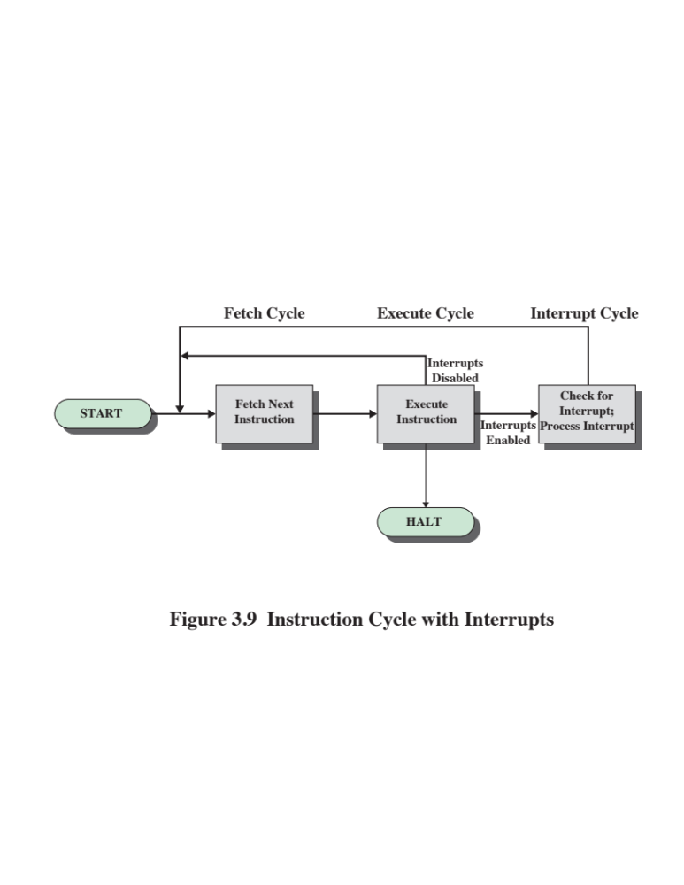
Interrupt Cycle
An interrupt cycle is added to the instruction cycle
Notes:
To accommodate interrupts, an interrupt cycle is added to the instruction
cycle, as shown in Figure 3.9. In the interrupt cycle, the processor checks to see if
any interrupts have occurred, indicated by the presence of an interrupt signal. If no
interrupts are pending, the processor proceeds to the fetch cycle and fetches the
next instruction of the current program. If an interrupt is pending, the processor
does the following:
• It suspends execution of the current program being executed and saves its
context. This means saving the address of the next instruction to be executed
(current contents of the program counter) and any other data relevant to the
processor’s current activity.
• It sets the program counter to the starting address of an interrupt handler routine.
The processor now proceeds to the fetch cycle and fetches the first instruction
in the interrupt handler program, which will service the interrupt. The interrupt
handler program is generally part of the operating system. Typically, this program
determines the nature of the interrupt and performs whatever actions are needed.
In the example we have been using, the handler determines which I/O module
generated the interrupt and may branch to a program that will write more data out
to that I/O module. When the interrupt handler routine is completed, the processor
can resume execution of the user program at the point of interruption.
It is clear that there is some overhead involved in this process. Extra instructions
must be executed (in the interrupt handler) to determine the nature of the interrupt
and to decide on the appropriate action. Nevertheless, because of the relatively large
amount of time that would be wasted by simply waiting on an I/O operation, the
processor can be employed much more efficiently with the use of interrupts.

Slide 32
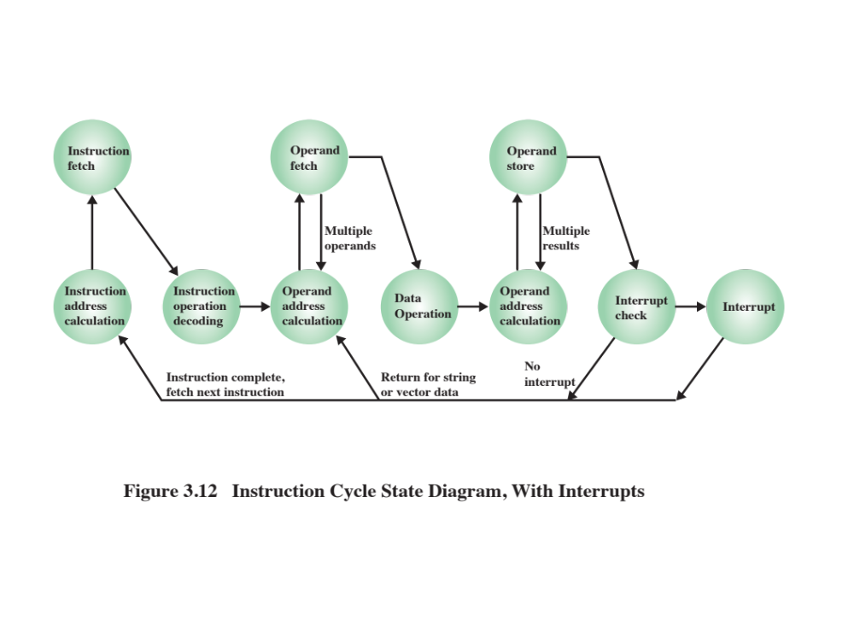
Notes:
Figure 3.12 shows a revised instruction cycle state diagram that includes
interrupt cycle processing.

Slide 33
Multiple Interrupts
Once interrupts are introduced, it become possible (likely?) that a interrupt will be thrown while the system is processing the handler for an earlier interrupt
There are two strategies to handle this situation.
Disabled interrupts – once the processor begins handling an interrupt, it will ignore further interrupts.
  If a further interrupt occurs it will usually remain pending so it can be handled once the current handler completes
  We need an interrupt queue
  This approach does not take into account priority or time-critical needs
Define interrupt priorities – a higher priority interrupt can interrupt the handler of one with a lower priority

Slide 34
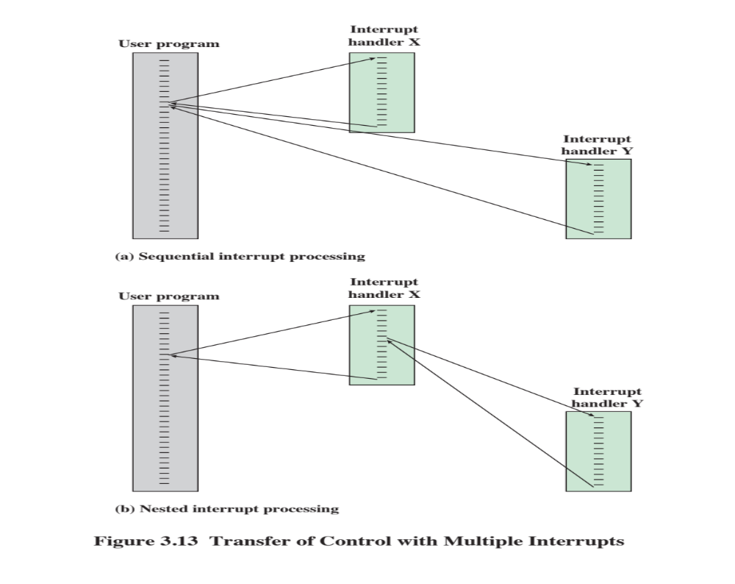
Notes:
Two approaches can be taken to dealing with multiple interrupts. The first is to
disable interrupts while an interrupt is being processed. A disabled interrupt simply
means that the processor can and will ignore that interrupt request signal. If an interrupt
occurs during this time, it generally remains pending and will be checked by
the processor after the processor has enabled interrupts. Thus, when a user program
is executing and an interrupt occurs, interrupts are disabled immediately. After the
interrupt handler routine completes, interrupts are enabled before resuming the
user program, and the processor checks to see if additional interrupts have occurred.
This approach is nice and simple, as interrupts are handled in strict sequential order
(Figure 3.13a).
The drawback to the preceding approach is that it does not take into account
relative priority or time-critical needs. For example, when input arrives from the
communications line, it may need to be absorbed rapidly to make room for more
input. If the first batch of input has not been processed before the second batch
arrives, data may be lost.
A second approach is to define priorities for interrupts and to allow an
interrupt of higher priority to cause a lower-priority interrupt handler to be itself
interrupted (Figure 3.13b).

Slide 35
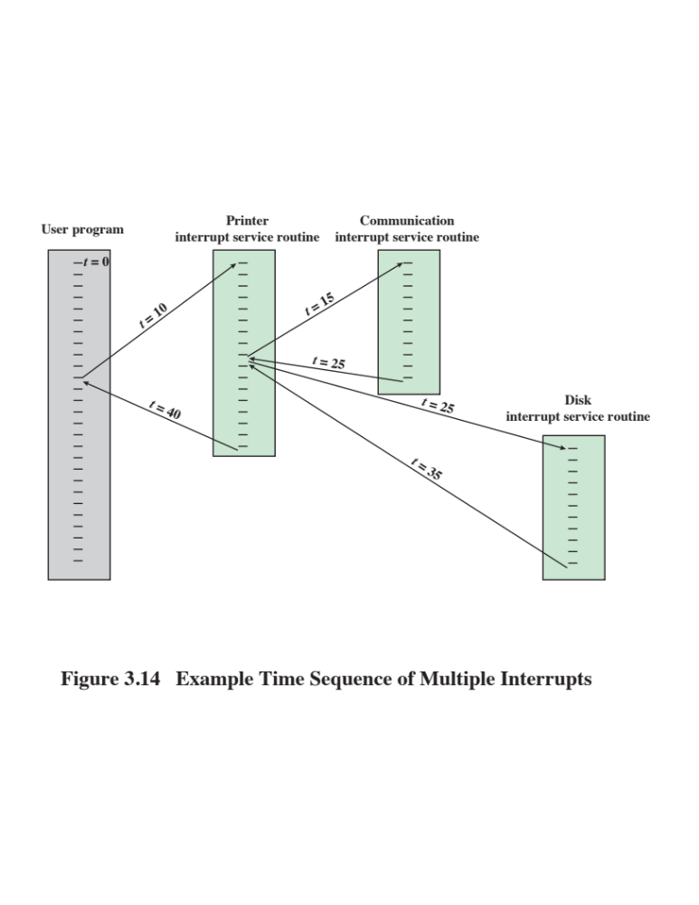
Notes:
As an example of this second approach, consider a
system with three I/O devices: a printer, a disk, and a communications line, with
increasing priorities of 2, 4, and 5, respectively. Figure 3.14 illustrates a possible
sequence. A user program begins at t = 0. At t = 10, a printer interrupt occurs; user
information is placed on the system stack and execution continues at the printer
interrupt service routine (ISR). While this routine is still executing, at t = 15, a
communications interrupt occurs. Because the communications line has higher
priority than the printer, the interrupt is honored. The printer ISR is interrupted,
its state is pushed onto the stack, and execution
continues at the communications ISR. While this routine is executing, a disk interrupt
occurs (t = 20). Because this interrupt is of lower priority, it is simply held, and the communications ISR runs
to completion.
When the communications ISR is complete (t = 25), the previous processor
state is restored, which is the execution of the printer ISR. However, before even a
single instruction in that routine can be executed, the processor honors the higher priority
disk interrupt and control transfers to the disk ISR. Only when that routine
is complete
(t = 35) is the printer ISR resumed. When that routine completes (t = 40),
control finally returns to the user program.

Slide 36
Priority Interrupts
As an example of this second approach, consider a system with three I/O devices: a printer, a disk, and a communications line, with increasing priorities of 2, 4, and 5, respectively
  A user program begins at t = 0
  At t = 10, a printer interrupt occurs
  While printer interrupt service routine (ISR) is still executing, at t = 15, a communications interrupt occurs.
    Because the communications line has higher priority than the printer, the interrupt is honored. The printer ISR is interrupted
  While this routine is executing, a disk interrupt occurs (t = 20)
    Because this interrupt is of lower priority, it is simply held, and the communications ISR runs to completion.
  When the communications ISR is complete (t = 25), the system processes the disk ISR because it has a higher priority
  Only when that routine is complete (t = 35) is the printer ISR resumed.
  When that routine completes (t = 40), control finally returns to the user program.

Slide 37
I/O Function
In addition to exchanging data with memory, the processor can exchange data directly with I/O modules
I/O modules control one or more devices
Processor can read data from or write data to an I/O module
Processor identifies a specific device that is controlled by a particular I/O module
I/O instructions rather than memory referencing instructions
In some cases it is desirable to allow I/O exchanges to occur directly with memory
The processor grants to an I/O module the authority to read from or write to memory so that the I/O memory transfer can occur without tying up the processor
The I/O module issues read or write commands to memory relieving the processor of responsibility for the exchange
This operation is known as direct memory access (DMA)
Notes:
An I/O module (e.g., a disk controller) can exchange data directly with the
processor. Just as the processor can initiate a read or write with memory, designating
the address of a specific location, the processor can also read data from or write data
to an I/O module. In this latter case, the processor identifies a specific device that is
controlled by a particular I/O module. Thus, an instruction sequence similar in form to
that of Figure 3.5 could occur, with I/O instructions rather than memory-referencing
instructions.
In some cases, it is desirable to allow I/O exchanges to occur directly with
memory. In such a case, the processor grants to an I/O module the authority to read
from or write to memory, so that the I/O-memory transfer can occur without tying up
the processor. During such a transfer, the I/O module issues read or write commands
to memory, relieving the processor of responsibility for the exchange. This operation
is known as direct memory access (DMA) and is examined in Chapter 7.

Slide 38
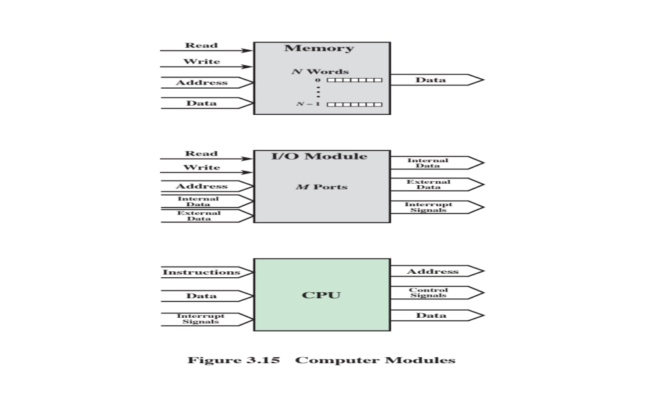
Notes:
A computer consists of a set of components or modules of three basic types
(processor, memory, I/O) that communicate with each other. In effect, a computer is
a network of basic modules. Thus, there must be paths for connecting the modules.
The collection of paths connecting the various modules is called the interconnection
structure. The design of this structure will depend on the exchanges that
must be made among modules.
Figure 3.15 suggests the types of exchanges that are needed by indicating the
major forms of input and output for each module type:
• Memory: Typically, a memory module will consist of N words of equal length.
Each word is assigned a unique numerical address (0, 1, …, N - 1). A word of
data can be read from or written into the memory. The nature of the operation
is indicated by read and write control signals. The location for the operation is
specified by an address.
• I/O module: From an internal (to the computer system) point of view, I/O
is functionally similar to memory. There are two operations, read and write.
Further, an I/O module may control more than one external device. We can
refer to each of the interfaces to an external device as a port and give each
a unique address (e.g., 0, 1, …, M - 1). In addition, there are external data
paths for the input and output of data with an external device. Finally, an I/O
module may be able to send interrupt signals to the processor.
• Processor: The processor reads in instructions and data, writes out data after
processing, and uses control signals to control the overall operation of the
system. It also receives interrupt signals.

Slide 39
The interconnection structure must support the following types of transfers:
Memory to processor
Processor reads an instruction or a unit of data from memory
Processor to memory
Processor writes a unit of data to memory
I/O to processor
Processor reads data from an I/O device via an I/O module
Processor to I/O
Processor sends data to the I/O device
I/O to or from memory
An I/O module is allowed to exchange data directly with memory without going through the processor using direct memory access
Notes:
The preceding list defines the data to be exchanged. The interconnection
structure must support the following types of transfers:
• Memory to processor: The processor reads an instruction or a unit of data
from memory.
• Processor to memory: The processor writes a unit of data to memory.
• I/O to processor: The processor reads data from an I/O device via an I/O
module.
• Processor to I/O: The processor sends data to the I/O device.
• I/O to or from memory: For these two cases, an I/O module is allowed to exchange
data directly with memory, without going through the processor, using
direct memory access.
Over the years, a number of interconnection structures have been tried. By
far the most common are (1) the bus and various multiple-bus structures, and (2)
point-to-point interconnection structures with packetized data transfer. We devote
the remainder of this chapter for a discussion of these structures.

Slide 40
Bus Interconnection
There needs to be a means for the different components of a computer system to communicate
Modern general-purpose computers use various specialized point-to-point interconnection structures
A common bus structure was previously dominant and is still used for many embedded systems
  Multiple devices connect to the bus
  A signal transmitted by one device can be received by any device on the bus
  The devices must be synchronized so that signals do not overlap
Notes:
An I/O module (e.g., a disk controller) can exchange data directly with the
processor. Just as the processor can initiate a read or write with memory, designating
the address of a specific location, the processor can also read data from or write data
to an I/O module. In this latter case, the processor identifies a specific device that is
controlled by a particular I/O module. Thus, an instruction sequence similar in form to
that of Figure 3.5 could occur, with I/O instructions rather than memory-referencing
instructions.
In some cases, it is desirable to allow I/O exchanges to occur directly with
memory. In such a case, the processor grants to an I/O module the authority to read
from or write to memory, so that the I/O-memory transfer can occur without tying up
the processor. During such a transfer, the I/O module issues read or write commands
to memory, relieving the processor of responsibility for the exchange. This operation
is known as direct memory access (DMA) and is examined in Chapter 7.

Slide 41
BUS
A bus is a communication system that transfers data between different components of a computer (CPU, memory, and I/O devices). Bus Interconnection refers to the way these buses are linked together to allow communication. Bus Speed=Clock Rate (MHz/GHz)
M-One Million and G= One Billion
📌 Types of Buses:
Data Bus – Transfers actual data (e.g., from RAM to CPU).
Address Bus – Carries memory addresses (e.g., where data should be stored).
Control Bus – Sends control signals (e.g., read/write operations)

Slide 42
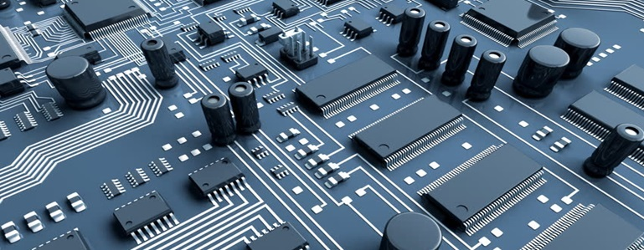
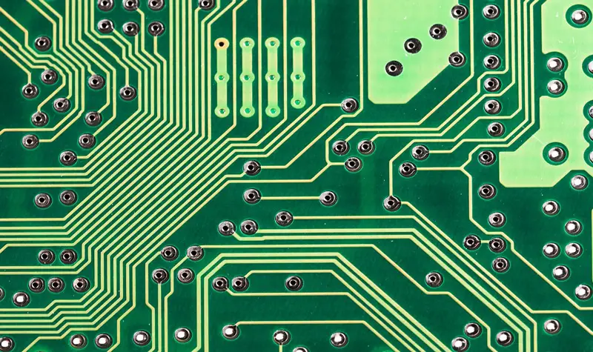
Con…
Example:
Imagine a school bus 🚌 picking up students (data) from different stops (memory, storage) and dropping them at school (CPU). The bus system ensures everything reaches the right place.

Slide 43
Key Points
✔ The wider the data bus, the more data can be transferred at once.
✔ If a CPU has a 32-bit data bus, it can transfer 32 bits of data at a time. (It can be more)
Think of the address bus like a GPS navigation system. Before fetching data, the CPU needs to know the exact memory location where the data is stored, just like entering an address into a GPS before driving.
The width of the address bus determines how much memory the CPU can access.
✔ If the CPU has a 16-bit address bus, it can access 2¹⁶ = 65,536 memory locations.
✔ A 32-bit address bus can access 2³² = 4GB of memory.
Example:
Think of the control bus like traffic lights 🚦. It controls when data should move (green light), when it should stop (red light), and what type of action should happen.
Key Control Signals:
✔ Read signal – Tells memory to send data to the CPU.
✔ Write signal – Tells memory to store data.
✔ Interrupt signal – Notifies the CPU of an urgent task (e.g., keyboard input).

Slide 44
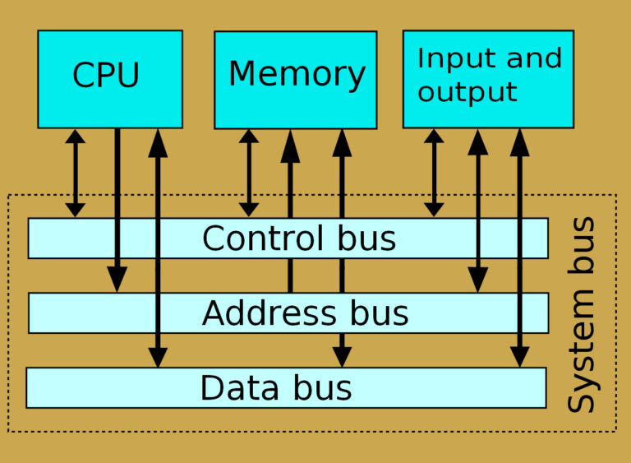
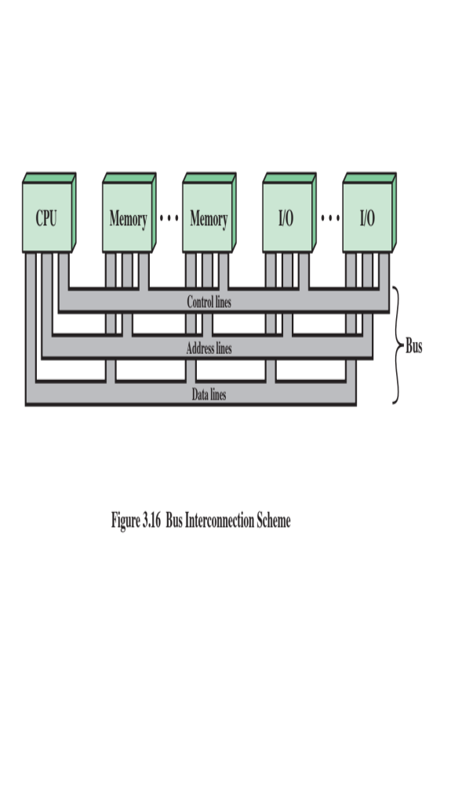
Notes:
Each line is assigned a particular meaning or function. Although there are
many different bus designs, on any bus the lines can be classified into three functional
groups (Figure 3.16): data, address, and control lines. In addition, there may
be power distribution lines that supply power to the attached modules.
The operation of the bus is as follows. If one module wishes to send data to
another, it must do two things: (1) obtain the use of the bus, and (2) transfer data
via the bus. If one module wishes to request data from another module, it must (1)
obtain the use of the bus, and (2) transfer a request to the other module over the
appropriate control and address lines. It must then wait for that second module to
send the data.

Slide 45
PCI (Peripheral Component Interconnect)
PCI is a high-speed hardware bus standard that connects peripheral devices like graphics cards, sound cards, network cards, and SSDs to the motherboard. PCI uses asynchronous communication
Example:
Think of PCI like a power strip 🔌 where multiple devices (GPU, WiFi adapter) can be plugged in. Each slot provides a pathway for communication between the CPU and the device.
Motherboard has PCI slots.
Devices (GPU, sound card) plug into these slots.
The PCI bus transfers data between CPU and devices.

Slide 46
PCI Layers
PCIe is described by a three layer architecture
Physical Layer – the physical wires that carry the data
  Also includes the circuitry and logic to support the transmission and receipt of 1’s and 0’s
Data Link Layer – responsible for reliable transmission and flow control
  Data packets at the data link layer are called DLLPs
Transaction Layer – generates and consumes data packets and manages the flow between two components
  Data packets at the transaction layer are called TLPs

Slide 47
QPI (Quick Path Interconnect)
QPI is Intel’s high-speed point-to-point interconnection between processors and memory controllers, replacing the old Front-Side Bus (FSB). Introduced in 2008, Multi Directional
Front Side Bus (FSB) in older computers used synchronous communication between the CPU and memory with a shared clock signal.
Advantages:
✔ Faster and more predictable.
✔ Efficient when transmitting continuous data.
Disadvantages:
❌ Limited by the clock speed – all devices must operate at the same rate.
❌ Difficult to scale across long distances.
📌 Example:
Imagine a multi-lane highway: Where cars (data) move faster because they don't need to stop at intersections (FSB bottlenecks).
📌 Key Features:
✔ Faster data transfer between CPU and memory.
✔ Point-to-point connection (dedicated lanes for data).
✔ Used in multi-processor systems like Intel Xeon servers.

Slide 48
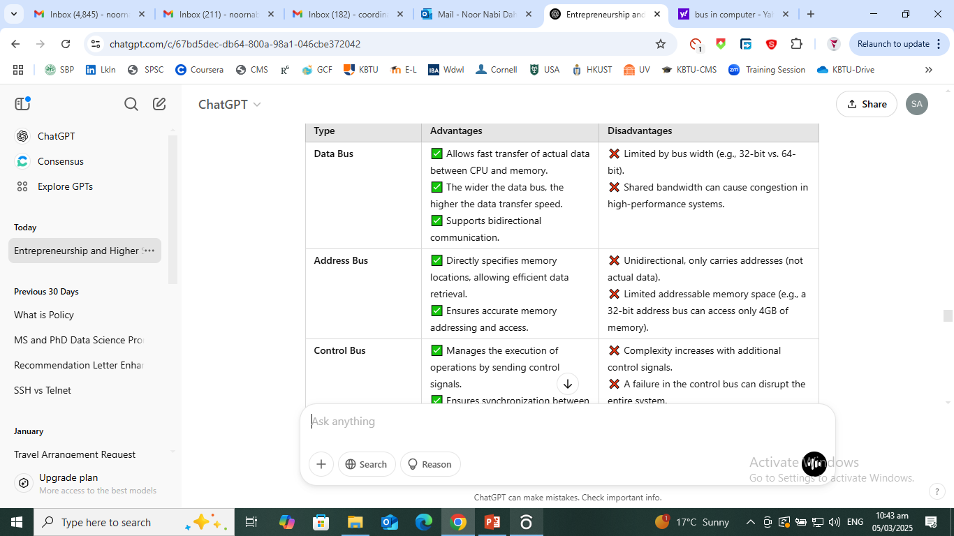
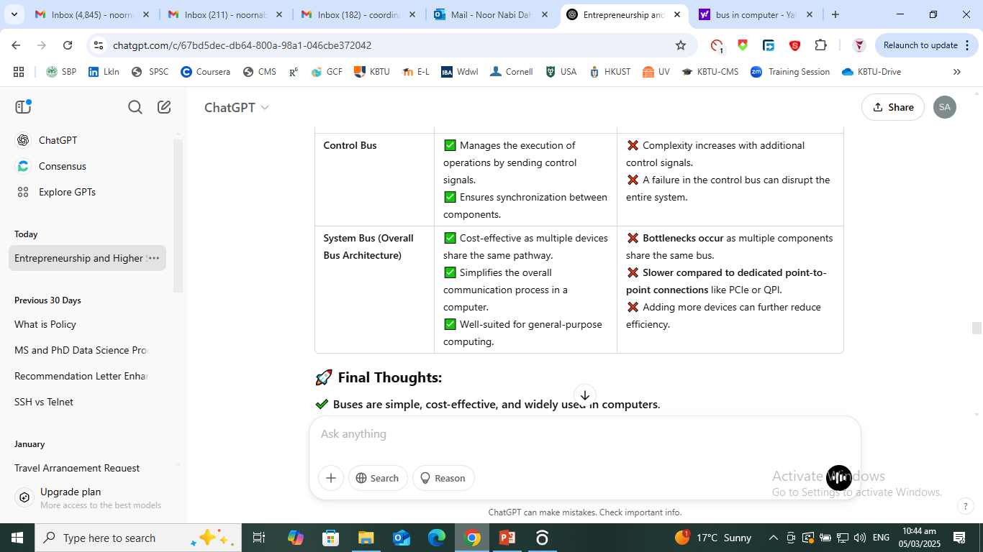

Slide 49
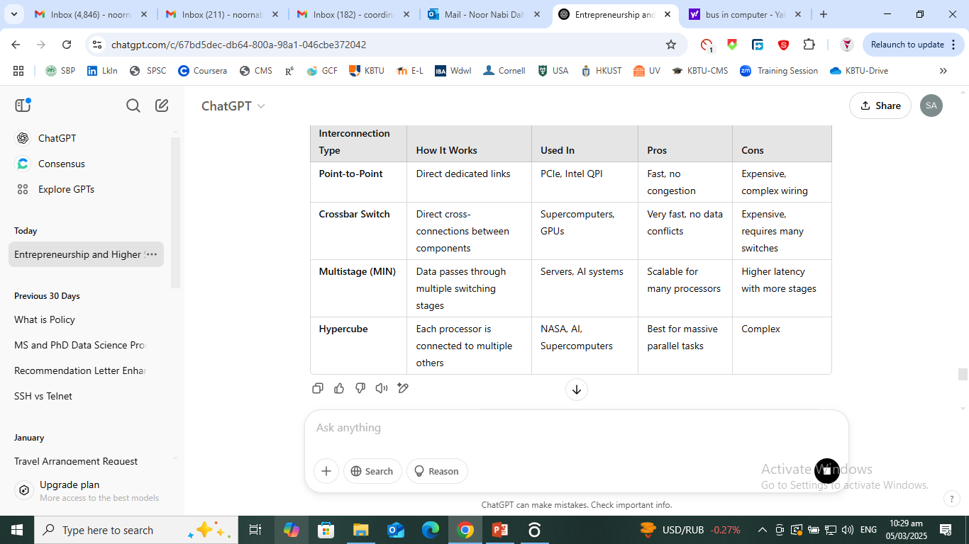
Other Interconnection Structures Used for Communication Inside a Computer
Latency refers to the time delay between a request and a response in a computer system
Switching is the process of directing data from a source to a destination across a network. It determines how data moves efficiently between devices.
📌 Example:
Imagine a postal system where letters (data) are sent through different post offices (switches) to reach their final destination.

Slide 50
Assignment
A Top-Level View of Computer Function and Interconnection
Chapter 3
Review Questions:
3.2, 3.3, 3.5
  Problems:
  3.1, 3.3, 3.5, 3.11, 3.12, 3.14
Notes:
Chapter 3 homework.

